Slide 1
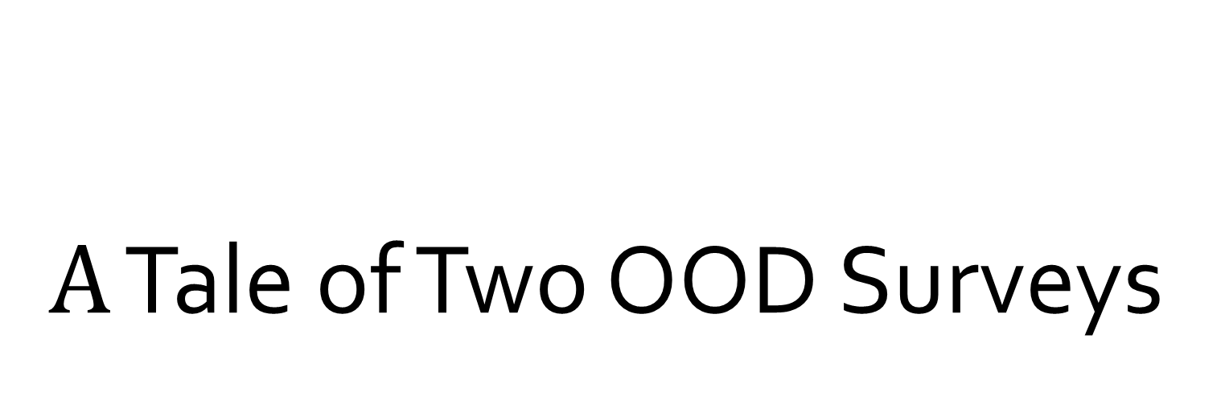
$A$ Tale of Two OOD Surveys
A brief summary of two out-of-distribution papers
Dongzhuyuan Lu
Sep 15, 2023

Slide 2
Table of Contents
1. Introduction to OOD
2. OOD Detection (Yang et al., 2021)
3. OOD Generalization (Shen et al., 2021)

Slide 3
Introduction
Motivation and formulation of out-of-distribution problem

Slide 4
Why do we need to consider OOD problem?
Most machine learning models assume that the testing data is drawn i.i.d. from the same distribution as training data.
In real world scenarios, test samples can be out-of-distribution (OOD).

Slide 5
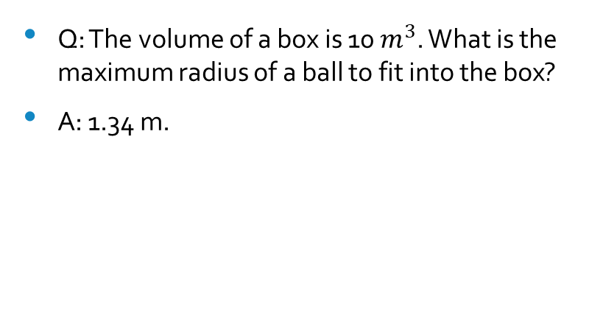
OOD Problem
Algebra (Training data)
Geometry (Testing data)
Q: One hamburger is $7, then how much do I need to pay for 10 hamburgers?
A: $70.
Q: The volume of a box is 10 $m^{3}$. What is the maximum radius of a ball to fit into the box?
A: 1.34 m.

Slide 6
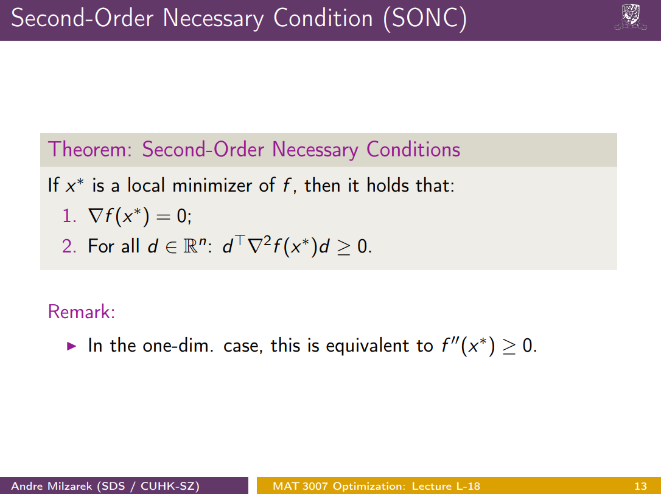
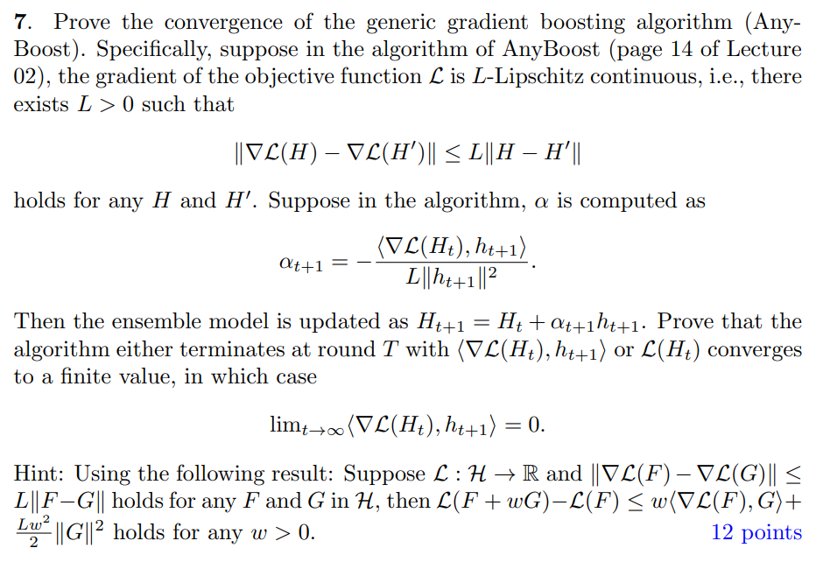
OOD Problem
Lecture (Training data)
Assignment (Testing data)

Slide 7
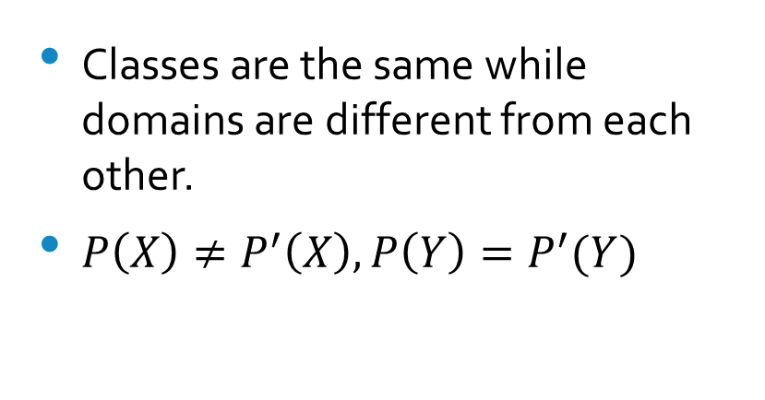
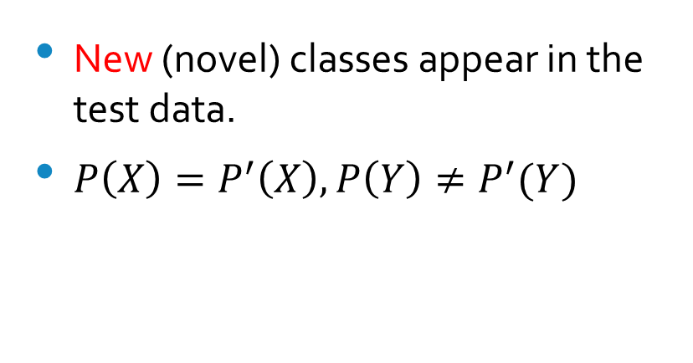
Types of Distributional Shifts
Semantic Shift
Covariate Shift
New (novel) classes appear in the test data.
$P\left(X\right)=P^{′}\left(X\right), P\left(Y\right)≠P^{′}(Y)$
Classes are the same while domains are different from each other.
$P\left(X\right)≠P^{′}\left(X\right), P\left(Y\right)=P^{′}(Y)$

Slide 8
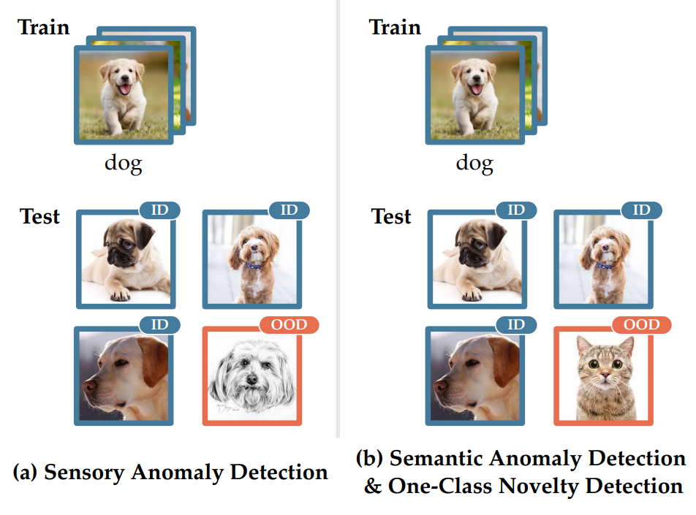
Covariate & Semantic Shifts

Slide 9
OOD Detection (semantic shift)
How to detect if the test data is novel or not?

Slide 10
OOD Subtasks
Anomaly Detection & One-class Novelty Detection
Open Set Recognition & Multi-class Novelty Detection
Outlier Detection

Slide 11
Methods
Density-based
Reconstruction-based
Classification-based
Distance-based
Gradient-based

Slide 12
Density-based Method
Classic Density Estimation: use parametric density (e.g. multivariate Gaussian distribution) or non-parametric one (e.g. histograms or kernel density estimation)
Density Estimation with Deep Generative Model: AE/VAE-based (encoding), GAN-based (map from latent space to target distribution) , Flow-based (a sequence of invertible mappings)
Energy-based (energy score) & Frequency-based

Slide 13
Reconstruction-based
Sparse Representation: normal sample can be constructed using a limited set of basis functions whereas novel data suffer from larger reconstruction cost.
Reconstruction-error method: a reconstruction model (e.g. AE, VAE, GAN) trained on the normal data will produce high-quality outcomes for normal test samples as apposed to anomalies.

Slide 14
Classification-based
One-class classification: learns a decision boundary.
Positive-Unlabeled Learning: unlabeled data is available.
EVT-based Uncertainty Calibration: Compact abating probability models the probability of class membership, and extreme value theory focuses on modeling the tail distribution with extreme high/low values.
Label space redesign: one-hot encoding ignores the inherent relationship among labels (cat/dog vs. cat/car).

Slide 15
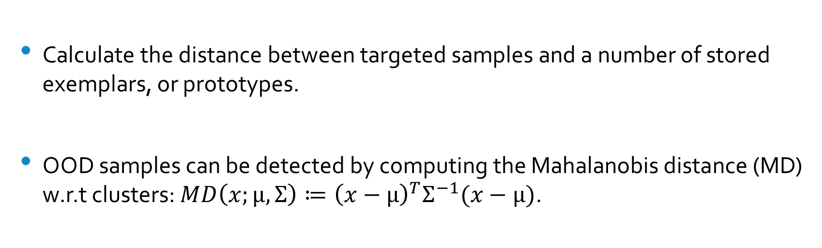
Distance-based
Calculate the distance between targeted samples and a number of stored exemplars, or prototypes.
OOD samples can be detected by computing the Mahalanobis distance (MD) w.r.t clusters: $MD\left(x;μ,Σ\right)≔{\left(x−μ\right)}^{T}Σ^{−1}(x−μ)$.

Slide 16
Gradient-based
Patterns of training gradient between normality and anomalies are different.
Example: ODIN proposed using input pre-processing by adding small perturbations obtained from input gradients.

Slide 17
Outlier Detection (transductive)
Requires observation of all samples and aims to detect those that deviate.
Methods:
Density: Models the entire dataset as Gaussian distribution and flags samples that are at least three standard deviations from the mean.
Distance: Samples that lie outside major clusters are recognized as outliers.
Classification using deep learning models.

Slide 18
OOD Detection in Large Language Model

Slide 19
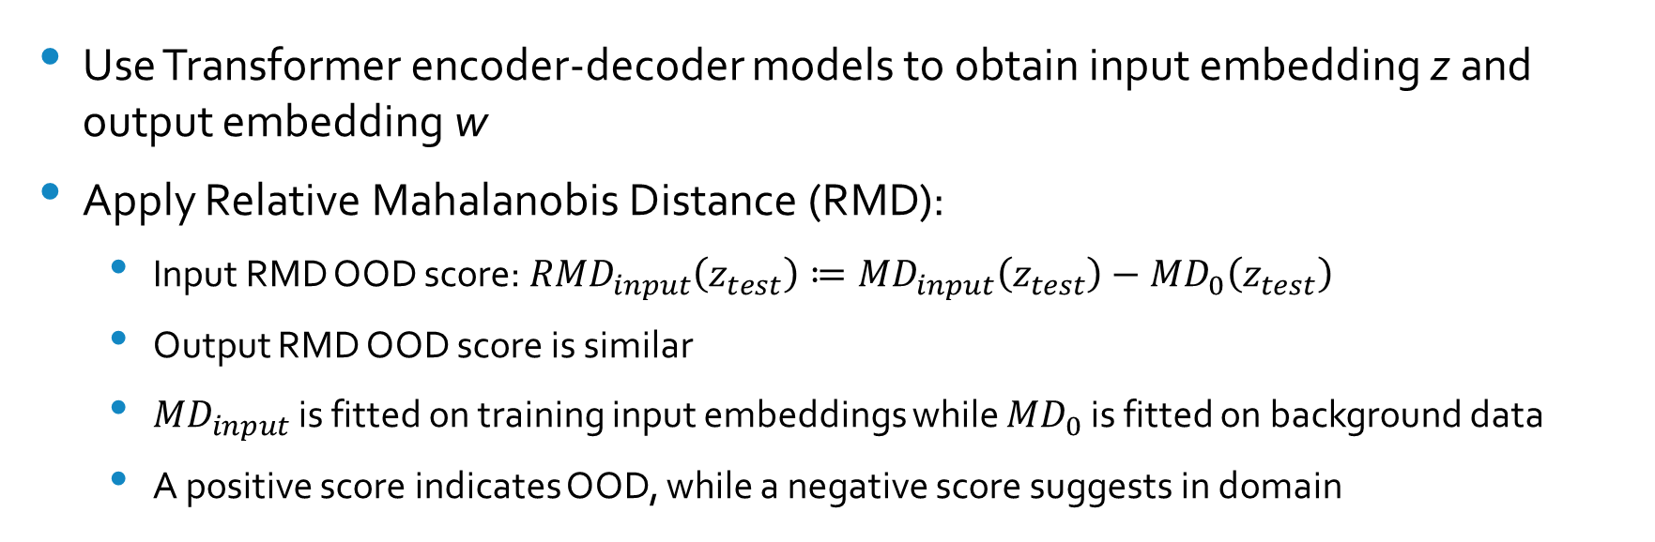
OOD Detection for CLMs (Ren et al., 2023)
Use Transformer encoder-decoder models to obtain input embedding z and output embedding w
Apply Relative Mahalanobis Distance (RMD):
Input RMD OOD score: ${RMD}_{input}\left(z_{test}\right)≔{MD}_{input}\left(z_{test}\right)−{MD}_{0}\left(z_{test}\right)$
Output RMD OOD score is similar
${MD}_{input}$ is fitted on training input embeddings while ${MD}_{0}$ is fitted on background data
A positive score indicates OOD, while a negative score suggests in domain

Slide 20
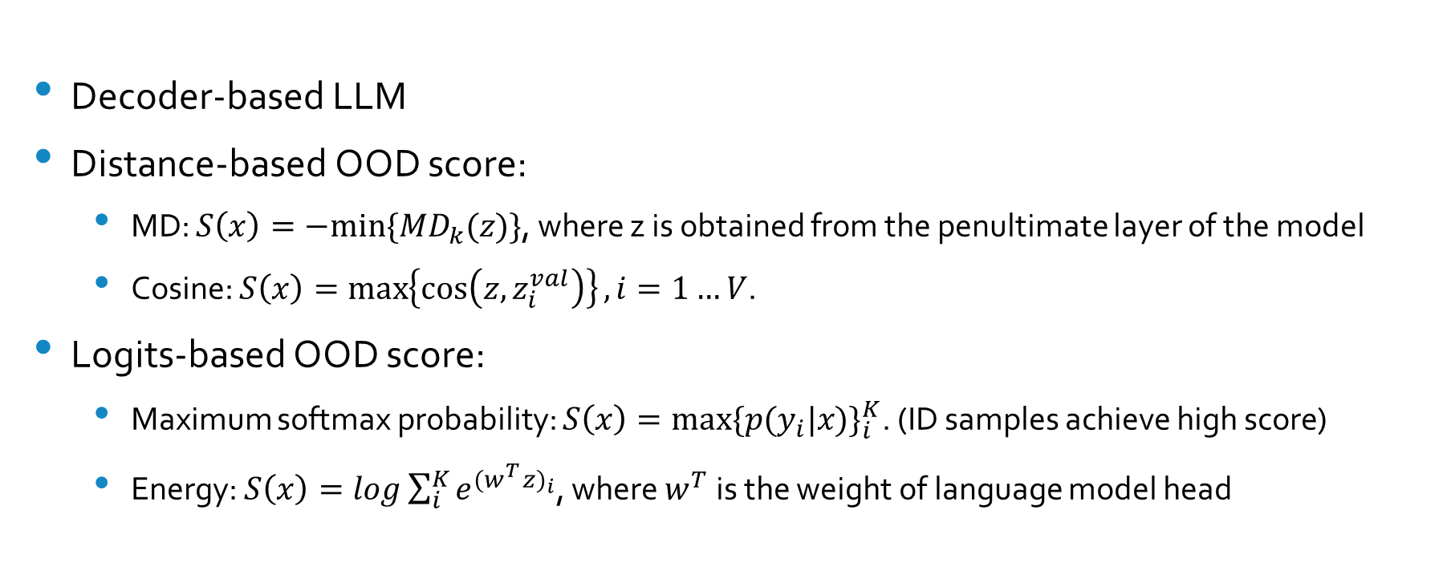
OOD Detection with LLaMA (Liu et al., 2023)
Decoder-based LLM
Distance-based OOD score:
MD: $S\left(x\right)=−min⁡\{{MD}_{k}(z)\}$, where z is obtained from the penultimate layer of the model
Cosine: $S\left(x\right)=\max\left\{\cos\left(z,z_{i}^{val}\right)\right\}, i=1…V$.
Logits-based OOD score:
Maximum softmax probability: $S\left(x\right)=max{\{p(y_{i}|x)\}}_{i}^{K}$. (ID samples achieve high score)
Energy: $S\left(x\right)=log\sum_{i}^{K}{e^{{(w_{}^{T}z)}_{i}}}$, where $w^{T}$ is the weight of language model head

Slide 21
OOD Generalization (covariate shift)
How to improve the performance if there exist covariate shift?

Slide 22
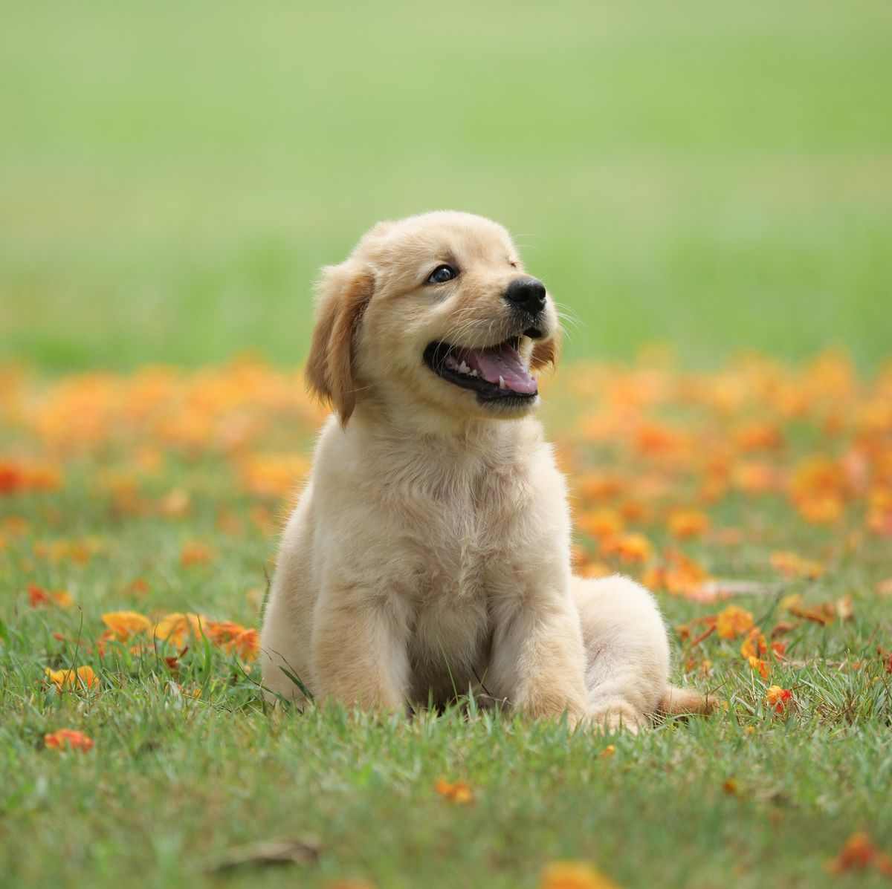

How to tackle covariate shift?
Train
Test
Distribution shifts but some discriminative features remain unchanged (invariance)!!!

Slide 23
Methods Categorization
Unsupervised Representation Learning
Supervised Model Learning
Optimization

Slide 24
Unsupervised Representation Learning
Disentangled Representation Learning: learn representations where distinct and informative factors or variations in data are separated (e.g. VAE-based methods).
Causal Representation Learning: learn variables in the causal graph (capture latent data generation process)

Slide 25
Supervised Model Learning
Domain Generalization
Learn models that generalizes well on unseen domains
Causal & Invariant Learning
Explore causal variables
Stable Learning

Slide 26
Domain Generalization
Representation learning:
Domain-adversarial neural network learns representations that are discriminative and invariant to domain change.
Domain alignment (features): minimize the distance between samples from different domains but same class, and maximize the other pairs.
Kernel methods: learn domain-invariant kernel.
Training strategy: meta learning, ensemble learning (from different source), self-supervised learning
Data augmentation: can improve generalization ability

Slide 27
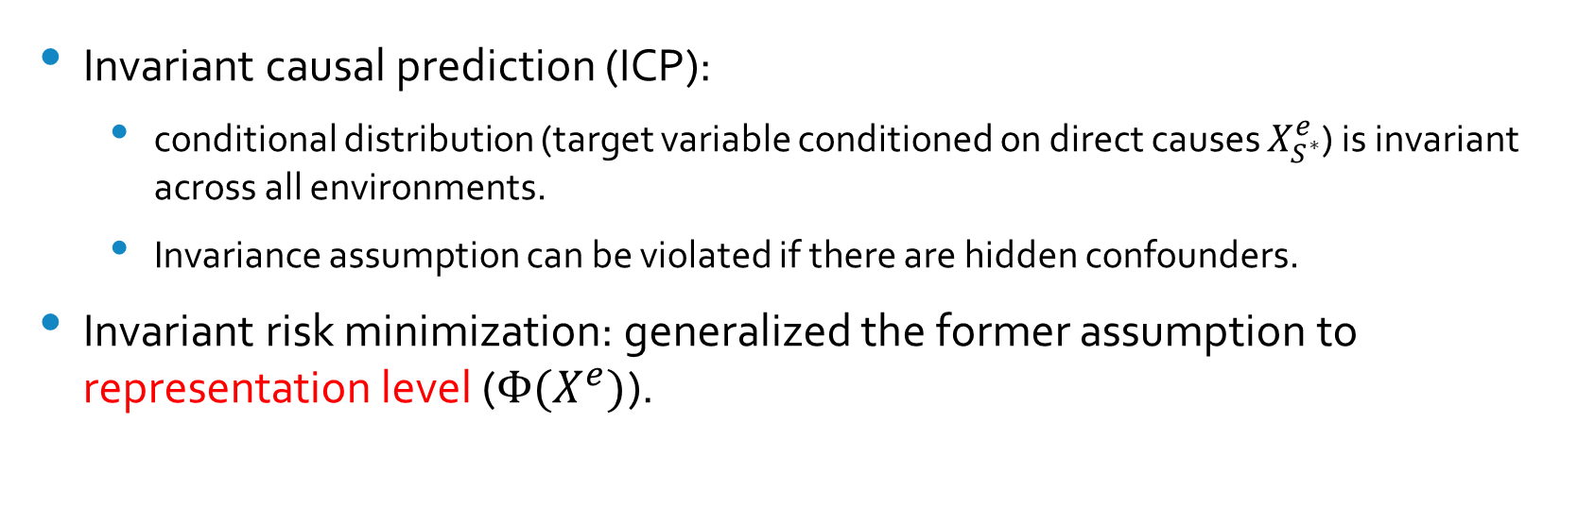
Causal & Invariant Learning
Invariant causal prediction (ICP):
conditional distribution (target variable conditioned on direct causes $X_{S^{∗}}^{e}$) is invariant across all environments.
Invariance assumption can be violated if there are hidden confounders.
Invariant risk minimization: generalized the former assumption to representation level ($Φ(X^{e})$).

Slide 28
Stable Learning
Relaxes the requirement for multiple environments.
Goal: learn a set of global sample weights that could remove the confounding bias for all the potential treatments from the data distribution.
Example: StableNet can partial out environment related features and leverage discriminative features.

Slide 29
Optimization for OOD Generalization
Distributionally Robust Optimization: minimize the worst case prediction error over an uncertainty distribution set (minmax problem).
Invariance-based Optimization: assumes the invariance property inside data and leverages multiple environments to find such invariance.

Slide 30
Finetuned Language Net (Wei et al., 2022)
Given 10 datasets (clusters), each within a specific domain (different tasks)
Hold out each cluster for evaluation while instruction tuning FLAN on all other clusters

Slide 31
Datasets
Synthetic data:
Selection bias
Confounding bias
Anti-causal effect
Real-world data

Slide 32
Evaluation Metric
We use accuracy as the evaluation metric
Average accuracy
Worst-case accuracy: for high-stake applications
Standard Deviation: reflects sensitivity

Slide 33
Thanks for listening!

